Slide 1


Algorithm Design Methods
Greedy method.
Divide and conquer.
Dynamic Programming.
Backtracking.
Branch and bound.

Slide 2
Some Methods Not Covered
Linear Programming.
Integer Programming.
Simulated Annealing.
Neural Networks.
Genetic Algorithms.
Tabu Search.

Slide 3
Optimization Problem
A problem in which some function (called the optimization or objective function) is to be optimized (usually minimized or maximized) subject to some constraints.

Slide 4
Machine Scheduling
Find a schedule that minimizes the finish time.
  optimization function … finish time
  constraints
    each job is scheduled continuously on a single machine for an amount of time equal to its processing requirement
    no machine processes more than one job at a time

Slide 5
Bin Packing
Pack items into bins using the fewest number of bins.
  optimization function … number of bins
  constraints
    each item is packed into a single bin
    the capacity of no bin is exceeded

Slide 6
Min Cost Spanning Tree
Find a spanning tree that has minimum cost.
  optimization function … sum of edge costs
  constraints
    must select n-1edges of the given n vertex graph
    the selected edges must form a tree

Slide 7
Feasible And Optimal Solutions
A feasible solution is a solution that satisfies the constraints.
An optimal solution is a feasible solution that optimizes the objective/optimization function.

Slide 8
Greedy Method
Solve problem by making a sequence of decisions.
Decisions are made one by one in some order.
Each decision is made using a greedy criterion.
A decision, once made, is (usually) not changed later.

Slide 9
Machine Scheduling
LPT Scheduling.
  Schedule jobs one by one and in decreasing order of processing time.
  Each job is scheduled on the machine on which it finishes earliest.
  Scheduling decisions are made serially using a greedy criterion (minimize finish time of this job).
  LPT scheduling is an application of the greedy method.

Slide 10
LPT Schedule
LPT rule does not guarantee minimum finish time schedules.
(LPT Finish Time)/(Minimum Finish Time) <= 4/3 - 1/(3m) where m is number of machines
Minimum finish time scheduling is NP-hard.
In this case, the greedy method does not work.
The greedy method does, however, give us a good heuristic for machine scheduling.

Slide 11

Container Loading
Ship has capacity c.
m containers are available for loading.
Weight of container i is w_{i}.
Each weight is a positive number.
Sum of container weights > c.
Load as many containers as is possible without sinking the ship.
Notes:
Similar to truck loading.

Slide 12
Greedy Solution
Load containers in increasing order of weight until we get to a container that doesn’t fit.
Does this greedy algorithm always load the maximum number of containers?
Yes. May be proved using a proof by induction (see text).

Slide 13
Container Loading With 2 Ships
Can all containers be loaded into 2 ships whose capacity is c (each)?
Same as bin packing with 2 bins.
  Are 2 bins sufficient for all items?
Same as machine scheduling with 2 machines.
  Can all jobs be completed by 2 machines in c time units?
NP-hard.

Slide 14















0/1 Knapsack Problem

Slide 15
0/1 Knapsack Problem
Hiker wishes to take n items on a trip.
The weight of item i is w_{i}.
The items are to be carried in a knapsack whose weight capacity is c.
When sum of item weights <= c, all n items can be carried in the knapsack.
When sum of item weights > c, some items must be left behind.
Which items should be taken/left?

Slide 16
0/1 Knapsack Problem
Hiker assigns a profit/value p_{i} to item i.
All weights and profits are positive numbers.
Hiker wants to select a subset of the n items to take.
  The weight of the subset should not exceed the capacity of the knapsack. (constraint)
  Cannot select a fraction of an item. (constraint)
  The profit/value of the subset is the sum of the profits of the selected items. (optimization function)
  The profit/value of the selected subset should be maximum. (optimization criterion)

Slide 17
0/1 Knapsack Problem
Let x_{i} = 1 when item i is selected and let x_{i} = 0 when item i is not selected.
n
p_{i} x_{i}
maximize
i = 1
n
w_{i} x_{i} <= c
subject to
i = 1
and x_{i} = 0 or 1 for all i
Notes:
Same as ship loading to maximize earnings. Each container has a weight and profit.

Slide 18
Greedy Attempt 1
Be greedy on capacity utilization.
  Select items in increasing order of weight.
n = 2, c = 7
w = [3, 6]
p = [2, 10]
only item 1 is selected
profit (value) of selection is 2
not best selection!

Slide 19
Greedy Attempt 2
Be greedy on profit earned.
  Select items in decreasing order of profit.
n = 3, c = 7
w = [7, 3, 2]
p = [10, 8, 6]
only item 1 is selected
profit (value) of selection is 10
not best selection!

Slide 20
Greedy Attempt 3
Be greedy on profit density (p/w).
  Select items in decreasing order of profit density.
n = 2, c = 7
w = [1, 7]
p = [10, 20]
only item 1 is selected
profit (value) of selection is 10
not best selection!

Slide 21
Greedy Attempt 3
Be greedy on profit density (p/w).
  Works when selecting a fraction of an item is permitted
  Select items in decreasing order of profit density, if next item doesn’t fit take a fraction so as to fill knapsack.
n = 2, c = 7
w = [1, 7]
p = [10, 20]
item 1 and 6/7 of item 2 are selected

Slide 22
0/1 Knapsack Greedy Heuristics
Select a subset with <= k items.
If the weight of this subset is > c, discard the subset.
If the subset weight is <= c, fill as much of the remaining capacity as possible by being greedy on profit density.
Try all subsets with <= k items and select the one that yields maximum profit.

Slide 23
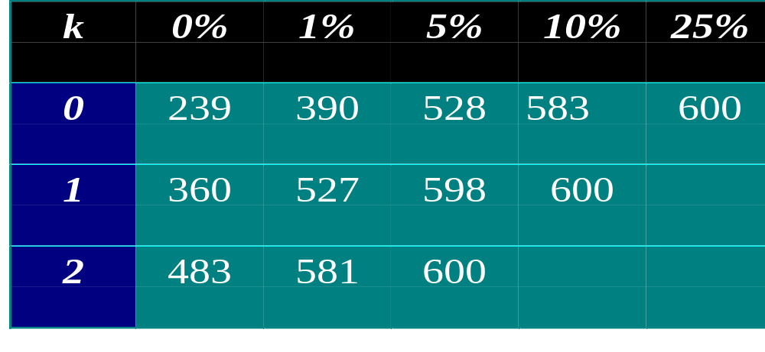
0/1 Knapsack Greedy Heuristics
(best value - greedy value)/(best value) <= 1/(k+1)
Number of solutions (out of 600) within x% of best.

Slide 24
0/1 Knapsack Greedy Heuristics
First sort into decreasing order of profit density.
There are O(n^{k}) subsets with at most k items.
Trying a subset takes O(n) time.
Total time is O(n^{k+1}) when k > 0.
(best value - greedy value)/(best value) <= 1/(k+1)

